Slide 1
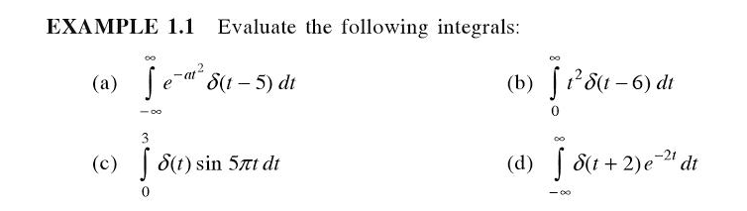

Slide 2
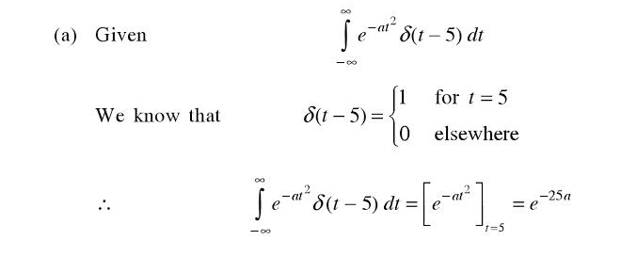

Slide 3
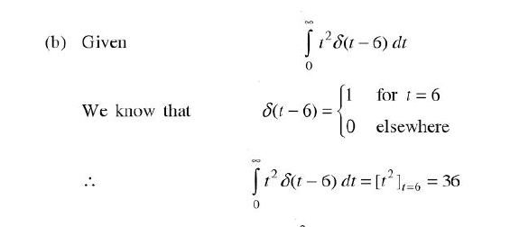

Slide 4
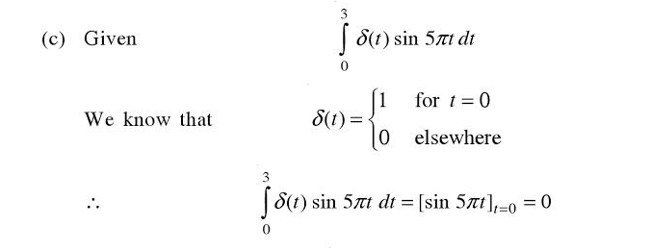

Slide 5
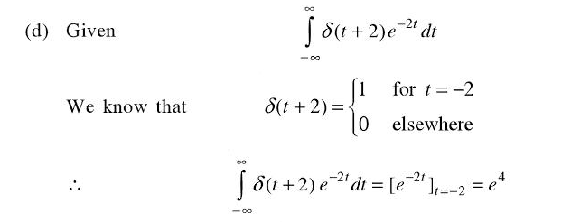

Slide 6
If a signal depends on only one independent variable
one dimensional
two dimensional
three dimensional
multidimensional

Slide 7
a

Slide 8
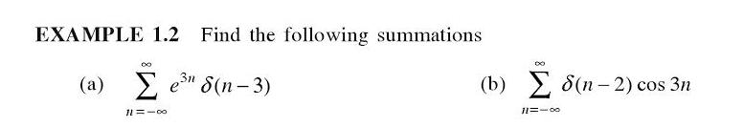

Slide 9
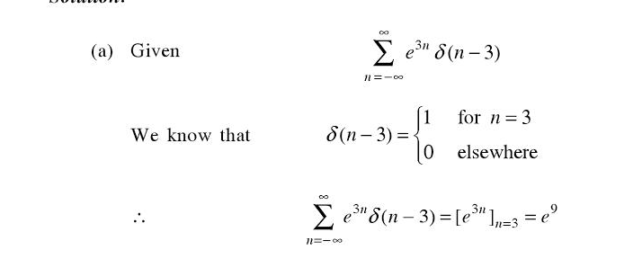

Slide 10
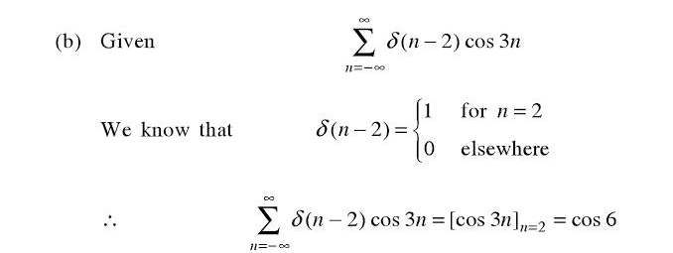

Slide 11
Operations on Signals

Slide 12
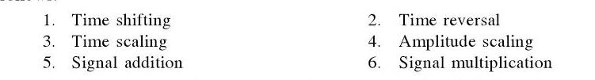

Slide 13
Time Shifting

Slide 14
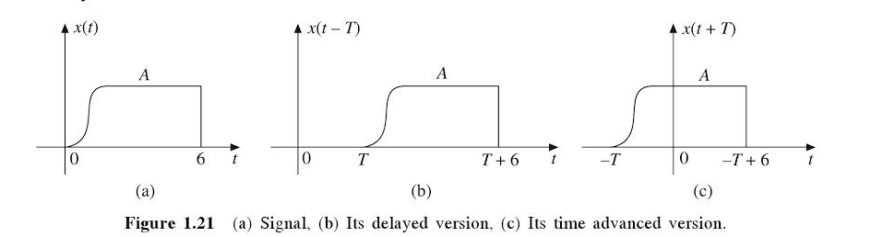

Slide 15
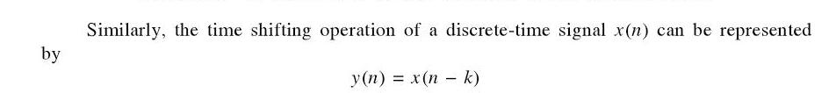

Slide 16
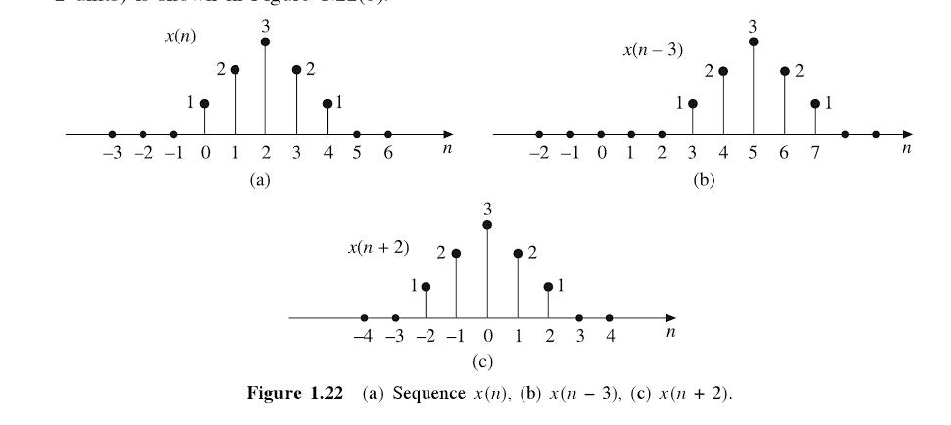

Slide 17
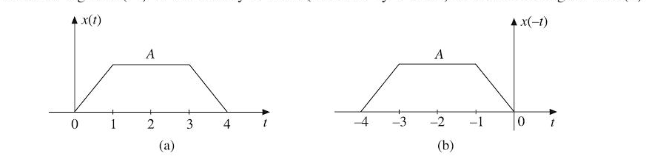
Time Reversal

Slide 18
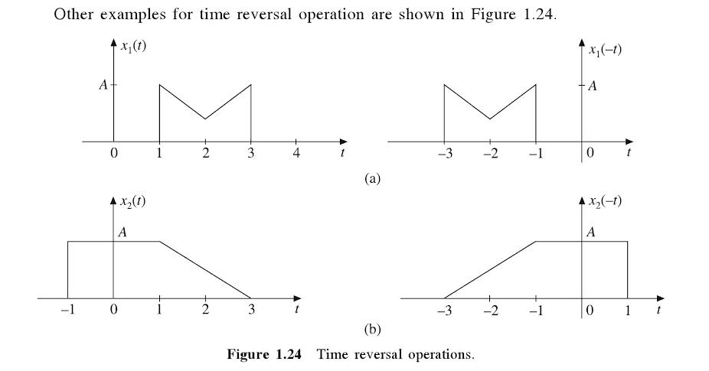

Slide 19
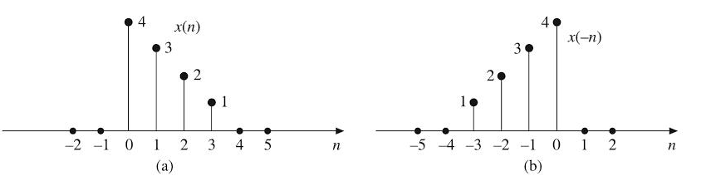

Slide 20
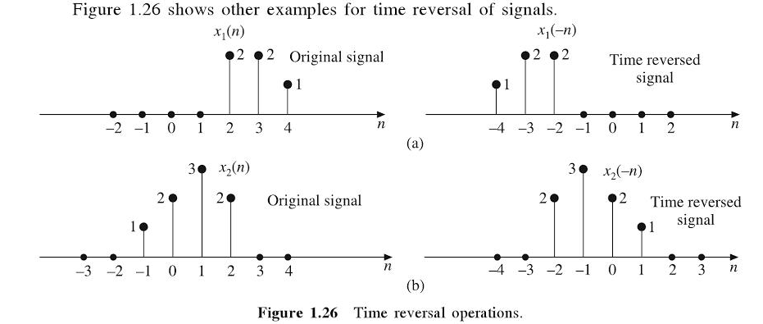

Slide 21
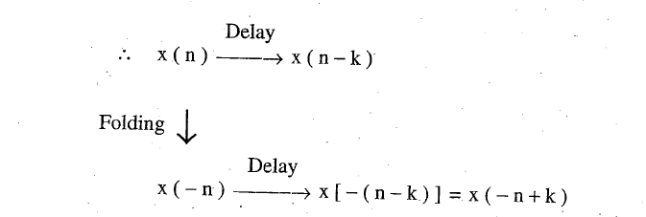
Folding and Delay

Slide 22
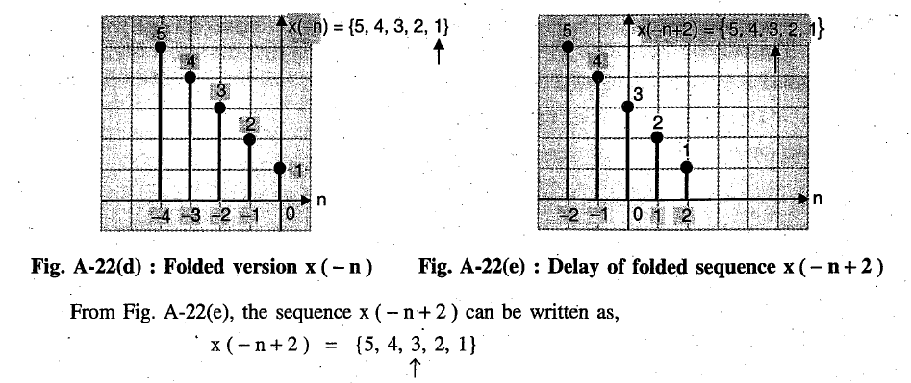

Slide 23
Discrete time signals are
Continuous in time and discrete in amplitude
Discrete in time and continuous in amplitude
Neither a and b
Both a and b

Slide 24
b

Slide 25
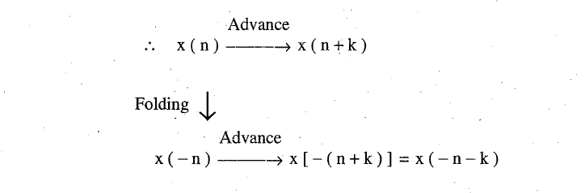
Folding and Advance

Slide 26
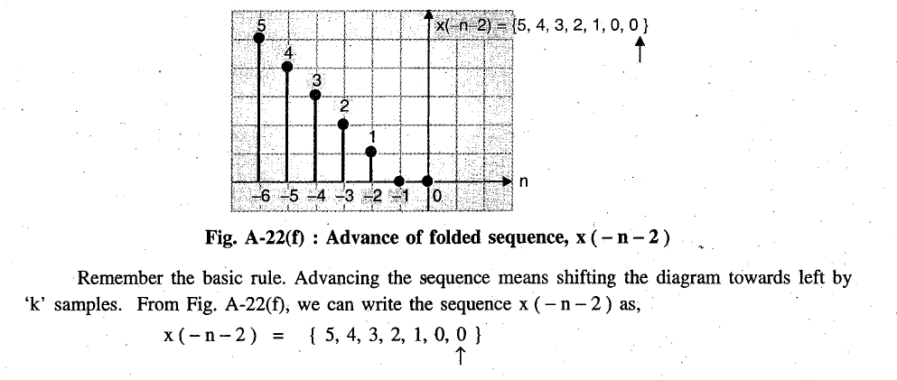

Slide 28
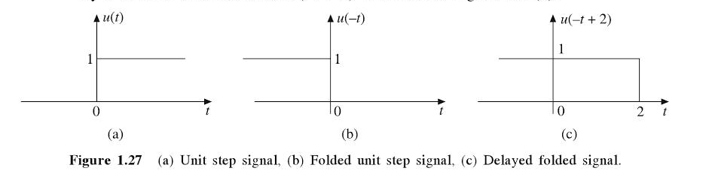

Slide 29
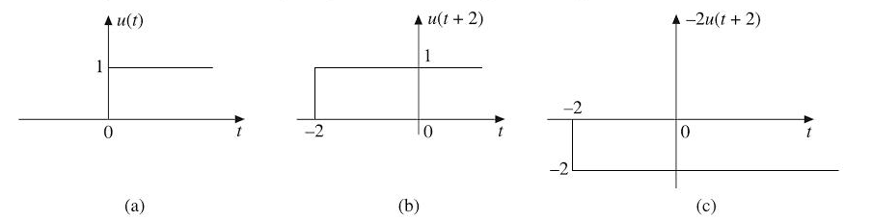

Slide 30

Amplitude Scaling

Slide 31
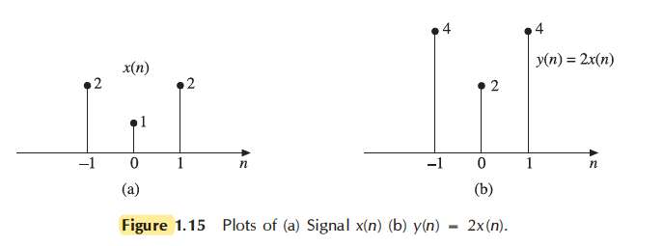

Slide 32
Which of the following is an example of amplitude scaling?
a) Electronic amplifier b) Electronic attenuator c) Both amplifier and attenuator d) Adder

Slide 33
c

Slide 34
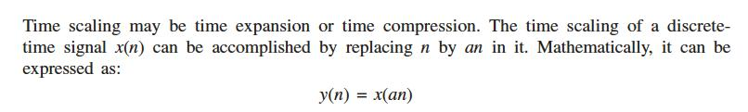
Time Scaling

Slide 35
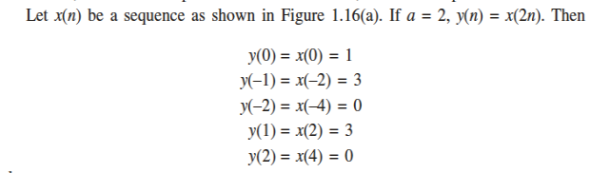
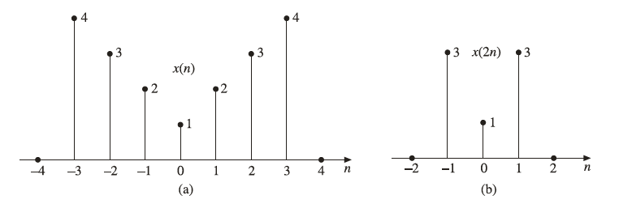

Slide 36
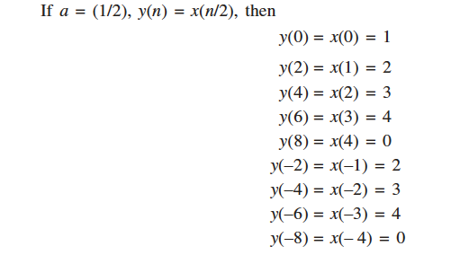

Slide 37
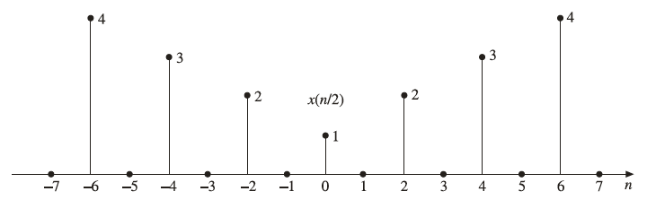

Slide 38
Y (t) = x (2t) is ________
a) Compressed signal b) Expanded signal c) Shifted signal d) Amplitude scaled signal by a factor of 2

Slide 39
A

Slide 40
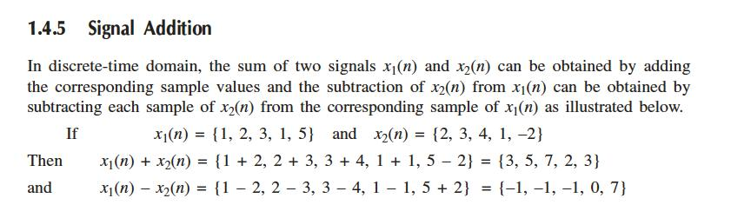

Slide 41
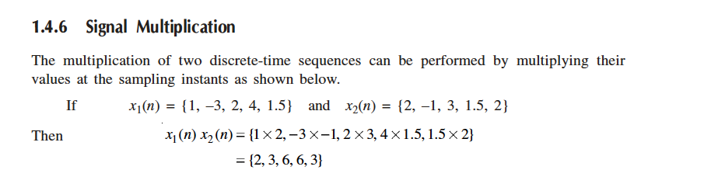

Slide 42
δ(n) can be rewritten as
u(n) +u (n-1)
u(n) u (n-1)
u(n) -u (n-1)
u(n-1) +u (n)

Slide 43
c

